Slide 1

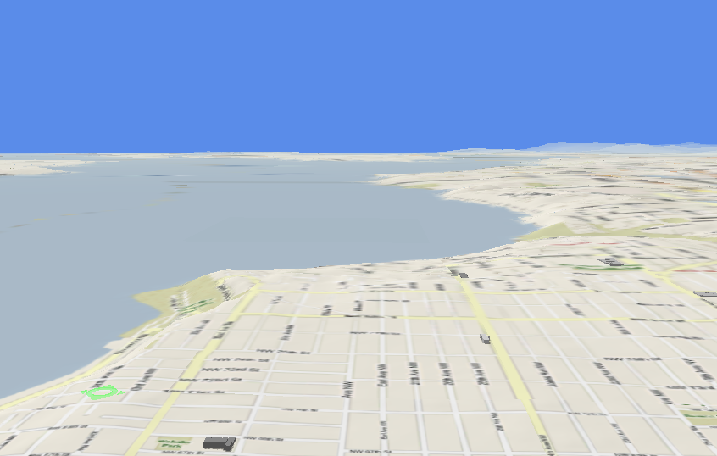





Trajectory Data Mining
Dr. Yu Zheng
Lead Researcher, Microsoft Research
Chair Professor at Shanghai Jiao Tong University
Editor-in-Chief of ACM Trans. Intelligent Systems and Technology
http://research.microsoft.com/en-us/people/yuzheng/
Notes:
A Location trajectory is a geospatial trail generated by a moving object. Typically, this trail is represented by of a set of time-ordered points.
The advance of location-acquisition technologies has boosted the increase of location trajectories, which record the trails of a variety of moving objects, such as people, vehicles, animals and nature phenomena.
These trajectories have not only enabled many applications significantly changing the way we live but also provided us with the scientific observations to understand the objects creating the trajectory.
As a result, the location trajectory has become the foundation a lot of research and attracted intensive attentions from a multitude of areas including computer sciences, biology, sociology, geography, and climatology, etc.

Slide 2
Paradigm of Trajectory Data Mining
Yu Zheng. Trajectory Data Mining: An Overview. ACM Transactions on Intelligent Systems and Technology. 2015, vol. 6, issue 3.

Slide 3
Trajectory Data Preprocessing
Noise filtering
Stay point detection
Trajectory compression
Trajectory Segmentation
Map matching

Slide 4
Trajectory Data Preprocessing
Noise filtering
Stay point detection
Trajectory compression
Trajectory Segmentation
Map matching

Slide 5
Noise Filtering
There are always noise points in a trajectory
Caused by poor positioning signal, e.g. Urban canyons
Cannot fixed by map matching algorithms

Slide 6
Methodologies for Noise Filtering
Mean (median) filters
The Kalman and Particle filters
Heuristics-Based Outlier Detection

Slide 7
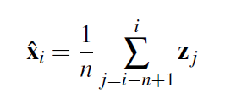
Mean (Median) Filter
Also called “moving average”
Apply to x and y measurements separately
Filtered version of this point is mean of points in solid box
z_{x}
t
It doesn’t look into future
Causes lag when values change sharply
Sensitive to outliers, i.e. one really bad point can cause mean to take on any value
Simple and effective

Slide 8
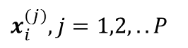
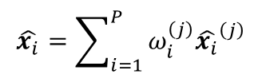

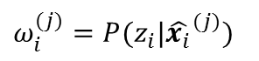
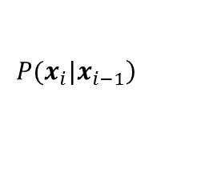
The Kalman and Particle filters
A tradeoff between the measurements and a motion model
The Kalman filter gains efficiency by assuming linear models plus Gauss­ian noise
The particle filter is a more general, but less efficient, algorithm
1) Generate P particles
3) Imp­or­tance weights
5) Compute a weight sum
$x_{i}^{(j)},j=1,2,..P$
$ω_{i}^{(j)}=P(z_{i}|{\hat{x_{i}}}^{(j)})$
$$\hat{x_{i}}=\sum_{i=1}^{P}{ω_{i}^{\left(j\right)}{\hat{x_{i}}}^{\left(j\right)}}$$
e.g. Gaussian distribution
Zero velocity
2) Importance sampling
4) Selection step
$$\left.P(x_{i}|x_{i−1}\right)$$
$ω_{i}^{\left(j\right)}$ (normalized)
Notes:
1. would have zero velocity and be clust­ered around the initial location measurement with a Gaussian distribution

Slide 9
Heuristics-Based Methods
Removes noise points from a trajectory using outlier detection algorithms
Insight: the number of noise points is much smaller than common points
Calculates the travel speed of each point
The segm­ents with a speed larger than a threshold are cut off
Distance-based outlier detection

Slide 10
Trajectory Data Preprocessing
Noise filtering
Stay point detection
Trajectory compression
Trajectory Segmentation
Map matching

Slide 11
Stay Point Detection
Some points denote locations where people have stayed for a while
Shopping malls and tourist attractions
Gas stati­ons where a vehicle was refueled
……
Two scenarios
$P=p_{1}→p_{2}→…→p_{n},$ $⇒$ $S=s_{1}\underset{→}{{∆t}_{1}}s_{2}\underset{→}{{∆t}_{2}},…,{\underset{→}{{∆t}_{n−1}}s}_{n}$
Q. Li, Y. Zheng, et al. Mining user similarity based on location history. ACM GIS 2008.
J. Yuan, Y. Zheng, et al. Where to Find My Next Passenger? UbiComp 2011

Slide 12
Trajectory Data Preprocessing
Noise filtering
Stay point detection
Trajectory compression
Trajectory Segmentation
Map matching

Slide 13
Trajectory Compression
Two categories of compression
Offline compression (a.k.a. batch mode)
Reduces the size of trajectory after the traj­ec­tory has been fully generated
Applications: content sharing sites, such as Everytrail and Bikely
Online compression
Compressing a trajectory instantly as an object travels
Applications: traffic monitoring and fleet management
Algorithms: Sliding Window, Open Window, and safe area-based methods
Two distance metrics
Perpendicular Euclidean Distance
Time Synchronized Euc­li­dean Distance

Slide 14
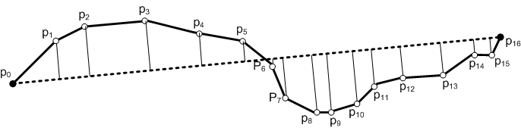
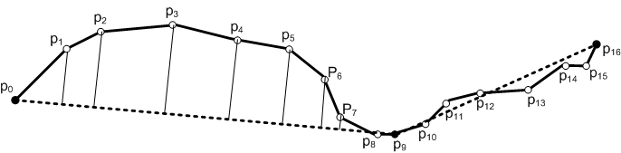
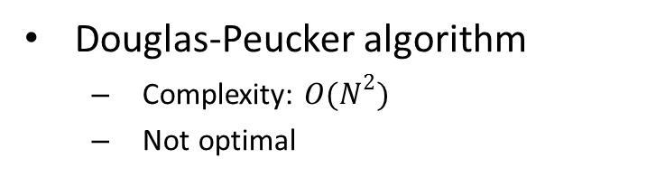
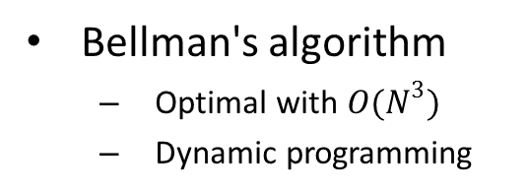
Offline Trajectory Compression
Douglas-Peucker algorithm
Complexity: $O(N^{2})$
Not optimal
Bellman's algorithm
Optimal with $O(N^{3})$
Dynamic programming
Split at the point with most error
Repeat until all the errors < given threshold

Slide 15
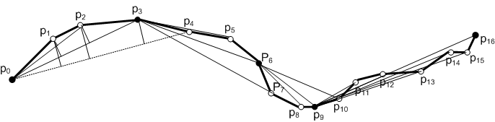
Sliding Window - Illustration
While the sliding window grows from {p₀} to {p₀, p₁, p₂, p₃}, all the errors between fitting line segments and the original trajectory are not greater than the specified error threshold.
When p₄ is included, the error for p₂ exceeds the threshold, so p₀p₃ is included in the approximate trajectory and p₃ is set as the anchor to continue.

Slide 16
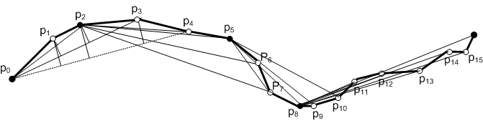
Open Window
Different from the sliding window, choose location points with the highest error in the sliding window as the closing point of the approximating line segment as well as the new anchor point.
When p₄ is included, the error for p₂ exceeds the threshold, so p₀p₂ is included in the approximate trajectory and p₂ is set as the anchor to continue.

Slide 17
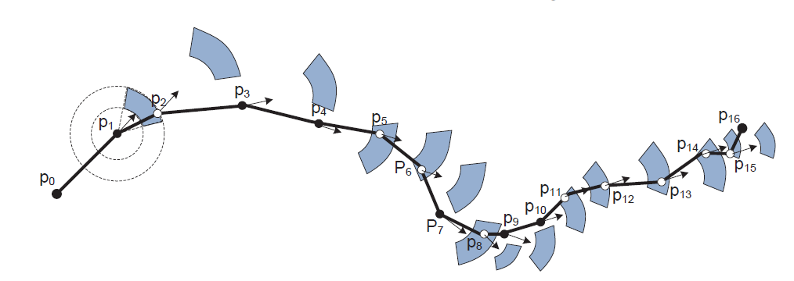
Safe Zone-Based Method - Illustration

Slide 18
Semantic Meaning-Based Methods (TS)
Keep the semantic meanings of a trajectory
Some special points would be more significant
a user stayed,
took photos, or
changed direction greatly
Yukun Chen, Kai Jiang, Yu Zheng, et al. Trajectory Simplification Method for Location-Based Social Networking Services. In LBSN 2009.

Slide 19
Douglas-Peucker algorithm

Slide 20
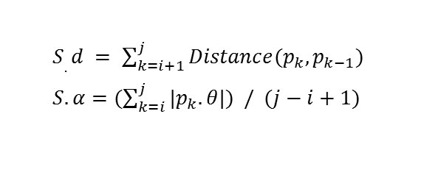
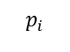
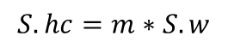
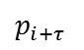
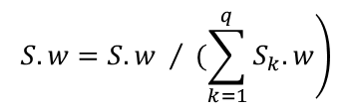
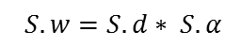
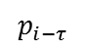
TS Algorithm - Illustration
Walk-based trajectory segmentation
Points assignment for each segment
Weight each point in each segment
$S.d = \sum_{k=i+1}^{j}{Distance(p_{k},p_{k−1})}$
$S.α=(\sum_{k=i}^{j}{{|p}_{k}.}θ|) / (j−i+1)$
$$\left.S.w=S.w / (\sum_{k=1}^{q}{S_{k}.w}\right)$$
$$S.hc=m∗S.w$$
$$S.w=S.d∗ S.α$$
Distance between a point and its nearest neighbors
Heading change of a point
Accumulated Heading Change
$$p_{i−τ }$$
$$p_{i+τ }$$
$$p_{i}$$

Slide 21
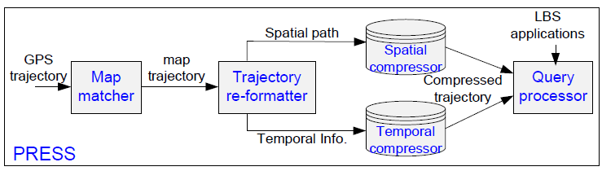
Trajectory Compression in Road Networks
PRESS
Trajectory compression on a road network
From <x, y, t> to a separate representation
Spatial compression is error free
Temporal compression is lossy
Works for online and offline
Renchu Song, Weiwei Sun, Baihua Zheng, Yu Zheng. PRESS: A Novel Framework of Trajectory Compression in Road Networks. VLDB 2014.

Slide 22
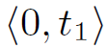
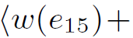
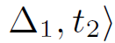
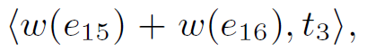
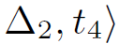
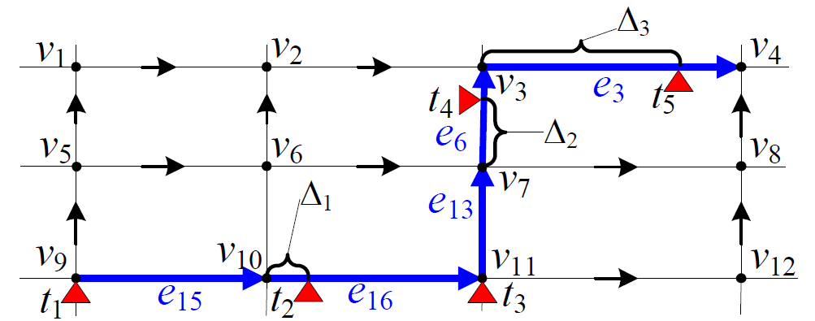
Methodology
Temporal representation: <d, t>
Notes:
d, is the distance to the initial point of the trajectory. T is the timestamp of the point.

Slide 23
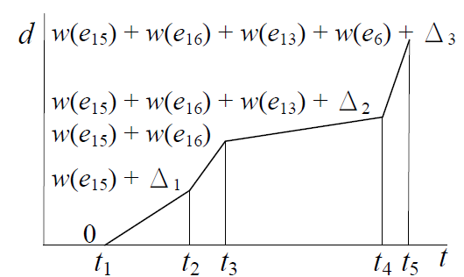
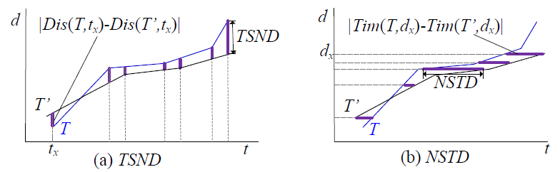
Methodology
Sliding-window-based compression
Error bounded
Lossy compression

Slide 24
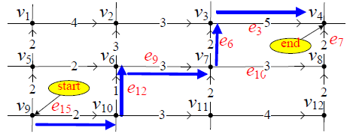
Methodology
Spatial representation
Shortest path: record the second last road segment
Frequent sub-trajectory patterns
Renchu Song, Weiwei Sun, Baihua Zheng, Yu Zheng. PRESS: A Novel Framework of Trajectory Compression in Road Networks. VLDB 2014.

Slide 25
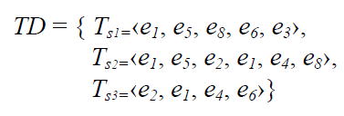
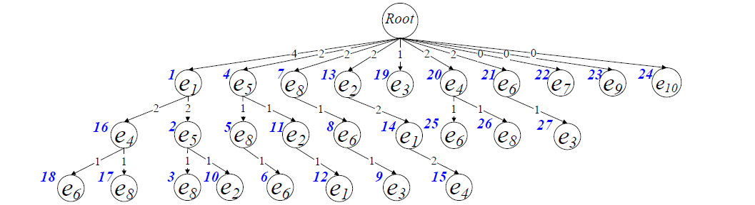
Methodology
Spatial representation
Frequent sub-trajectory (FST) patterns

Slide 26
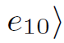
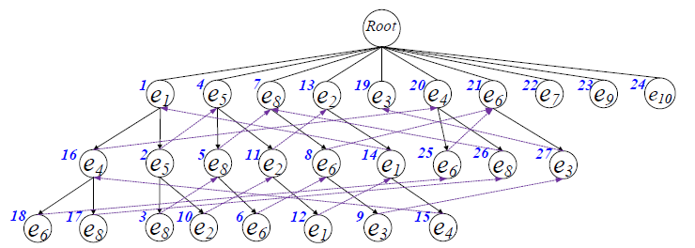
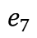
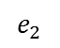
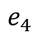
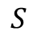
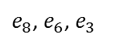
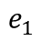
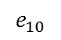
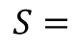
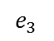
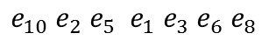
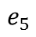
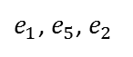
Methodology
Decompose a trajectory into FST patterns
Aho-Corasick string matching algorithm
Time complexity: O(|T|)
$${{e_{10} e}_{2} e}_{5} {{e_{1} e}_{3} e}_{6} e_{8}$$
$$e_{5}$$
$$e_{7}$$
$$e_{4}$$
$$e_{1}$$
$$S=$$
{24, 10, 2, 1, 9, 6, 5,
4,
22,
16,
1}
$$S$$
24
$$e_{10}$$
10
$$e_{2}$$
$e_{1}$, $e_{5}$, $e_{2}$
9
$$e_{3}$$
$e_{8}$, $e_{6}$, $e_{3}$

Slide 27
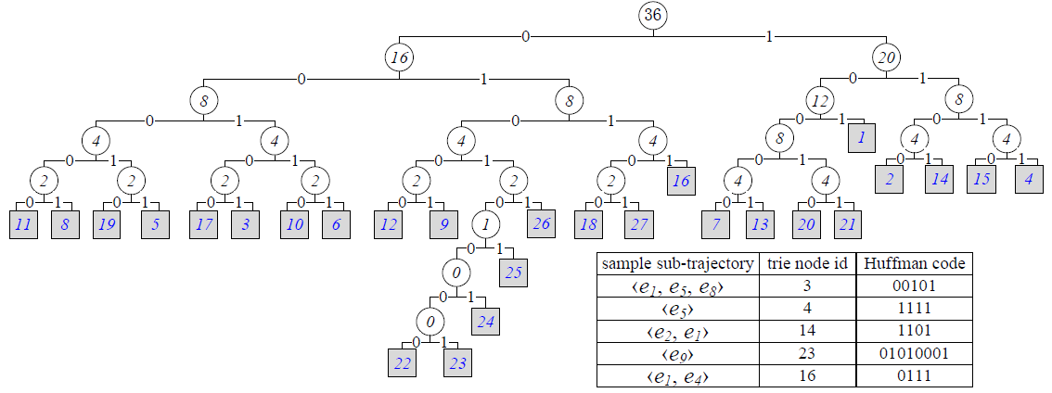
Methodology
Spatial compression
Huffman encoding + Trajectory patterns
Download data and codes
Renchu Song, Weiwei Sun, Baihua Zheng, Yu Zheng. PRESS: A Novel Framework of Trajectory Compression in Road Networks. VLDB 2014.

Slide 28
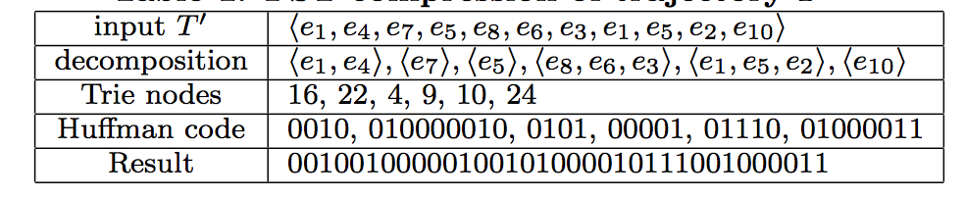
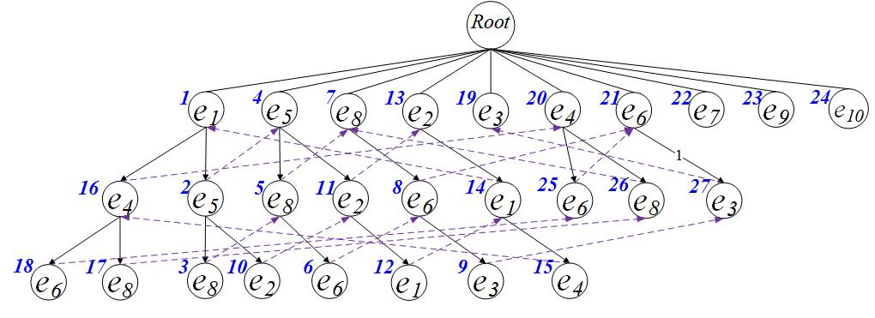
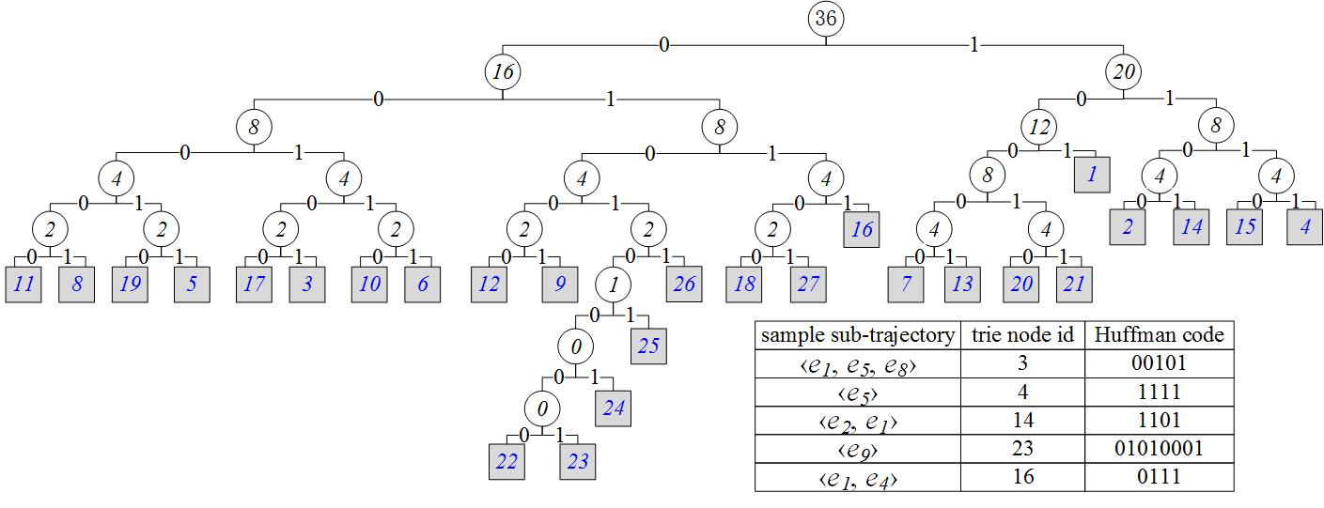
Methodology
Download data and codes
Frequent sub-trajectory compression example:
0111, 01010000, 1111, 01001, 00110, 0101001
011101010000111101001001100101001
Renchu Song, Weiwei Sun, Baihua Zheng, Yu Zheng. PRESS: A Novel Framework of Trajectory Compression in Road Networks. VLDB 2014.

Slide 29
Trajectory Data Preprocessing
Noise filtering
Stay point detection
Trajectory compression
Trajectory Segmentation
Map matching

Slide 30
Trajectory Segmentation
Partition a trajectory into segments for
Indexing and retrieval ^{[1]}
Clustering: sub-trajectory patterns ^{[2]}
Classification: learning transportation modes ^{[3]}
……
[1] Longhao Wang, Yu Zheng, et al. A Flexible Spatio-Temporal Indexing Scheme for Large-Scale GPS Track Retrieval, MDM 2008
[2] J. G. Lee, J. Han, and K. Y. Whang. Trajectory clustering: A partition-and-group framework. SIGMOD 2007
[3] Yu Zheng, et al. Understanding Mobility Based on GPS Data. UbiComp 2008

Slide 31
Trajectory Segmentation
Segmentation Methods based on
Time interval
Shape of trajectory
Turning Point-based
Minimal Description Language
Douglas-Peucker algorithm
Semantic meaning of points
Stay point-based
Transportation mode-based

Slide 32

Trajectory Segmentation
Minimal Description Language-based method
$L(H)$:
the length, in bits, of the description of the hypothesis $H$
denotes the total length of partitioned segments
$L\left(D | H\right)$:
the length of the description of the data D when encoded with the hypothesis
Denotes the error
The best hypothesis is the H that minimizes $L(H)$ + $L(D|H)$
[2] J. G. Lee, J. Han, and K. Y. Whang. Trajectory clustering: A partition-and-group framework. SIGMOD 2007

Slide 33

Trajectory Segmentation
Transportation mode-based method
Typically, people need to walk before transferring transportation modes
Typically, people need to stop and then go when transferring modes

Slide 34
Trajectory Segmentation
Transportation mode-based method
Step 1: distinguish all possible Walk Points, non-Walk Points.
Step 2: merge short segment composed by consecutive Walk Points or non-Walk points
Step 3: merge consecutive Uncertain Segment to non-Walk Segment.
Step 4: end point of each Walk Segment are potential change points
[3] Yu Zheng, et al. Understanding Mobility Based on GPS Data. UbiComp 2008

Slide 35
Trajectory Data Preprocessing
Noise filtering
Stay point detection
Trajectory compression
Trajectory Segmentation
Map matching

Slide 36

Map-matching
Problem
Map a GPS trajectory onto a road network
a sequence of GPS points → a sequence of road segments

Slide 37

Spatial Data
Road network: G=(V, E)
V is a set of nodes
E is a set of road segments
$e∈E$, consists of two terminal nodes and a sequence of intermediate points describing the segment with a polyline
Properties: $e.len$, $e.dir$, $e.lanes$

Slide 38
Map-Matching
Why it is important
A fundamental step in many transportation applications
Navigation and driving
Traffic analysis
Taxi dispatching and recommendations
Examples:
Find the vehicles passing Nanjing road
Calculate the average travel time from Tsinghua to MSRA campus
When will the NO. 53 bus arrive at SJUT stop?
….

Slide 39
Map-Matching
Why difficult

Slide 40

Map-Matching
Simple solution for high-sampling-rate data
Weighted distance
Yin Lou, Chengyang Zhang, Yu Zheng, et al. Map-Matching for Low-Sampling-Rate GPS Trajectories. In ACM SIGSPATIAL GIS 2009

Slide 41
Map-Matching
According to the additional information used
Geometric
Topological
Probabilistic
Advanced techniques
According to the range of sampling points
Local/incremental
Global
Advanced
Yu Zheng. Trajectory Data Mining: An Overview. ACM Transaction on Intelligent Systems and Technology, 6, 3, 2015.

Slide 42
Map-matching
Insights
Consider both local and global information
Incorporating both spatial and temporal features
Yin Lou, Chengyang Zhang, Yu Zheng, et al. Map-Matching for Low-Sampling-Rate GPS Trajectories. In ACM SIGSPATIAL GIS 2009

Slide 43


Map-matching
Solution (incorporating spatial information)
Model local possibility
Considering context (global)
$$N\left(c_{i}^{j}\right)=\frac{1}{\sqrt{2π}σ}e^{− \frac{{(x_{i}^{j}−μ)}^{2}}{2σ^{2}}}$$
$$V\left(c_{i−1}^{t}→c_{i}^{s}\right)=\frac{d_{i−1→ i}}{w_{\left(i−1,t\right)→(i,s)}}$$
$$F_{s}\left(c_{i−1}^{t}→c_{i}^{s}\right)=N\left(c_{i}^{s}\right)∗V\left(c_{i−1}^{t}→c_{i}^{s}\right), 2≤i≤n$$
Yin Lou, Chengyang Zhang, Yu Zheng, et al. Map-Matching for Low-Sampling-Rate GPS Trajectories. In ACM SIGSPATIAL GIS 2009

Slide 44


Map-matching
Solution
Considering temporal information
$$F_{t}\left(c_{i−1}^{t}→c_{i}^{s}\right)=\frac{\sum_{u=1}^{k}{(e_{u}^{′}.v ×{\overline{v}}_{\left(i−1,t\right)→(i,s)})}}{\sqrt{\sum_{u=1}^{k}{{(e_{u}^{′}.v)}^{2}}}×\sqrt{\sum_{u=1}^{k}{{\overline{v}}_{\left(i−1,t\right)→(i,s)}^{2}}}}$$
$${\overline{v}}_{\left(i−1,t\right)→(i,s)} =\frac{\sum_{u=1}^{k}{l_{u} }}{{∆t}_{i−1→ i}}$$
Yin Lou, Chengyang Zhang, Yu Zheng, et al. Map-Matching for Low-Sampling-Rate GPS Trajectories. In ACM SIGSPATIAL GIS 2009

Slide 45
Map-matching
Aggregating
Spatial and temporal information
Local and global information
Dynamic programing
$$F\left(c_{i−1}^{t}→c_{i}^{s}\right)=F_{s}\left(c_{i−1}^{t}→c_{i}^{s}\right)∗V\left(c_{i−1}^{t}→c_{i}^{s}\right)$$
Yin Lou, Chengyang Zhang, Yu Zheng, et al. Map-Matching for Low-Sampling-Rate GPS Trajectories. In ACM SIGSPATIAL GIS 2009

Slide 46
An Improved Version: Interactive-Voting
Key insights
Mutual influence (considering a farther distance)
Weighted influence (based on distance)
Jing Yuan, Yu Zheng, et al. An Interactive-Voting based Map Matching Algorithm. MDM 2010.

Slide 47















Interactive-Voting-Based Map-Matching
$$M=\left[\begin{matrix}0.8 & 0.6 & −∞ & −∞ & −∞ & −∞ & −∞ \\ 0.7 & 0.5 & −∞ & −∞ & −∞ & −∞ & −∞ \\ 0.6 & 0.4 & −∞ & −∞ & −∞ & −∞ & −∞ \\ −∞ & −∞ & 0.3 & 0.7 & −∞ & −∞ & −∞ \\ −∞ & −∞ & 0.2 & 0.4 & −∞ & −∞ & −∞ \\ −∞ & −∞ & −∞ & −∞ & 0.3 & 0.5 & 0.4 \\ −∞ & −∞ & −∞ & −∞ & 0.6 & 0.7 & 0.9\end{matrix}\right]$$
$$0.8$$
$$0.3$$
$$p_{2}$$
$$p_{3}$$
$$p_{n}$$
$$0.4$$
$$0.4$$
$$W_{1}= \left[\begin{matrix}1/2 & & \\ & 1/4 & \\ & & 1/8\end{matrix}\right]$$
$$Φ_{i}=W_{i}M$$
$$F_{s}\left(c_{i−1}^{t}→c_{i}^{s}\right)=N\left(c_{i}^{s}\right)∗V\left(c_{i−1}^{t}→c_{i}^{s}\right)$$
$$w_{ij}=2^{\left.−(dist\left(p_{i},p_{j}\right)\right)}$$
$$Φ_{1}=\left[\begin{matrix}0.4 & 0.3 & −∞ & −∞ & −∞ & −∞ & −∞ \\ 0.35 & 0.25 & −∞ & −∞ & −∞ & −∞ & −∞ \\ 0.3 & 0.2 & −∞ & −∞ & −∞ & −∞ & −∞ \\ −∞ & −∞ & 0.075 & 0.175 & −∞ & −∞ & −∞ \\ −∞ & −∞ & 0.05 & 0.1 & −∞ & −∞ & −∞ \\ −∞ & −∞ & −∞ & −∞ & 0.038 & 0.063 & 0.05 \\ −∞ & −∞ & −∞ & −∞ & 0.075 & 0.088 & 0.113\end{matrix}\right]$$
$$Φ_{3}=\left[\begin{matrix}0.2 & 0.15 & −∞ & −∞ & −∞ & −∞ & −∞ \\ 0.175 & 0.125 & −∞ & −∞ & −∞ & −∞ & −∞ \\ 0.15 & 0.1 & −∞ & −∞ & −∞ & −∞ & −∞ \\ −∞ & −∞ & 0.15 & 0.35 & −∞ & −∞ & −∞ \\ −∞ & −∞ & 0.1 & 0.2 & −∞ & −∞ & −∞ \\ −∞ & −∞ & −∞ & −∞ & 0.15 & 0.25 & 0.2 \\ −∞ & −∞ & −∞ & −∞ & 0.3 & 0.35 & 0.45\end{matrix}\right]$$
$$Φ_{2}=\left[\begin{matrix}0.4 & 0.3 & −∞ & −∞ & −∞ & −∞ & −∞ \\ 0.35 & 0.25 & −∞ & −∞ & −∞ & −∞ & −∞ \\ 0.3 & 0.2 & −∞ & −∞ & −∞ & −∞ & −∞ \\ −∞ & −∞ & 0.15 & 0.35 & −∞ & −∞ & −∞ \\ −∞ & −∞ & 0.1 & 0.2 & −∞ & −∞ & −∞ \\ −∞ & −∞ & −∞ & −∞ & 0.08 & 0.13 & 0.1 \\ −∞ & −∞ & −∞ & −∞ & 0.15 & 0.18 & 0.23\end{matrix}\right]$$
$$Φ_{4}=\left[\begin{matrix}0.1 & 0.075 & −∞ & −∞ & −∞ & −∞ & −∞ \\ 0.088 & 0.063 & −∞ & −∞ & −∞ & −∞ & −∞ \\ 0.075 & 0.05 & −∞ & −∞ & −∞ & −∞ & −∞ \\ −∞ & −∞ & 0.075 & 0.175 & −∞ & −∞ & −∞ \\ −∞ & −∞ & 0.05 & 0.1 & −∞ & −∞ & −∞ \\ −∞ & −∞ & −∞ & −∞ & 0.15 & 0.25 & 0.2 \\ −∞ & −∞ & −∞ & −∞ & 0.3 & 0.35 & 0.45\end{matrix}\right]$$

Slide 48

Interactive-Voting-Based Map-Matching
Interactive Voting Scheme
Each candidate point determines an optimal path based on their own weighted score matrix $Φ_{i}$
Each point on the best path gets a vote from that candidate point
The points with the most number of votes are selected
Can be processed in parallel
+1
+1
+1
+1
+1
+1
+1
+2

Slide 49
Trajectory Data Preprocessing
Noise filtering
Stay point detection
Trajectory compression
Trajectory Segmentation
Map matching

Slide 50


Thanks!
Yu Zheng
yuzheng@microsoft.com
Homepage
Yu Zheng. Trajectory Data Mining: An Overview.
ACM Transactions on Intelligent Systems and Technology. 2015, vol. 6, issue 3.

